Slide 1



Power BI Report
View in Power BI
Last data refresh:
2/23/2021 5:56:04 PM GMT Standard Time
Downloaded at:
2/23/2021 6:00:10 PM GMT Standard Time

Slide 2
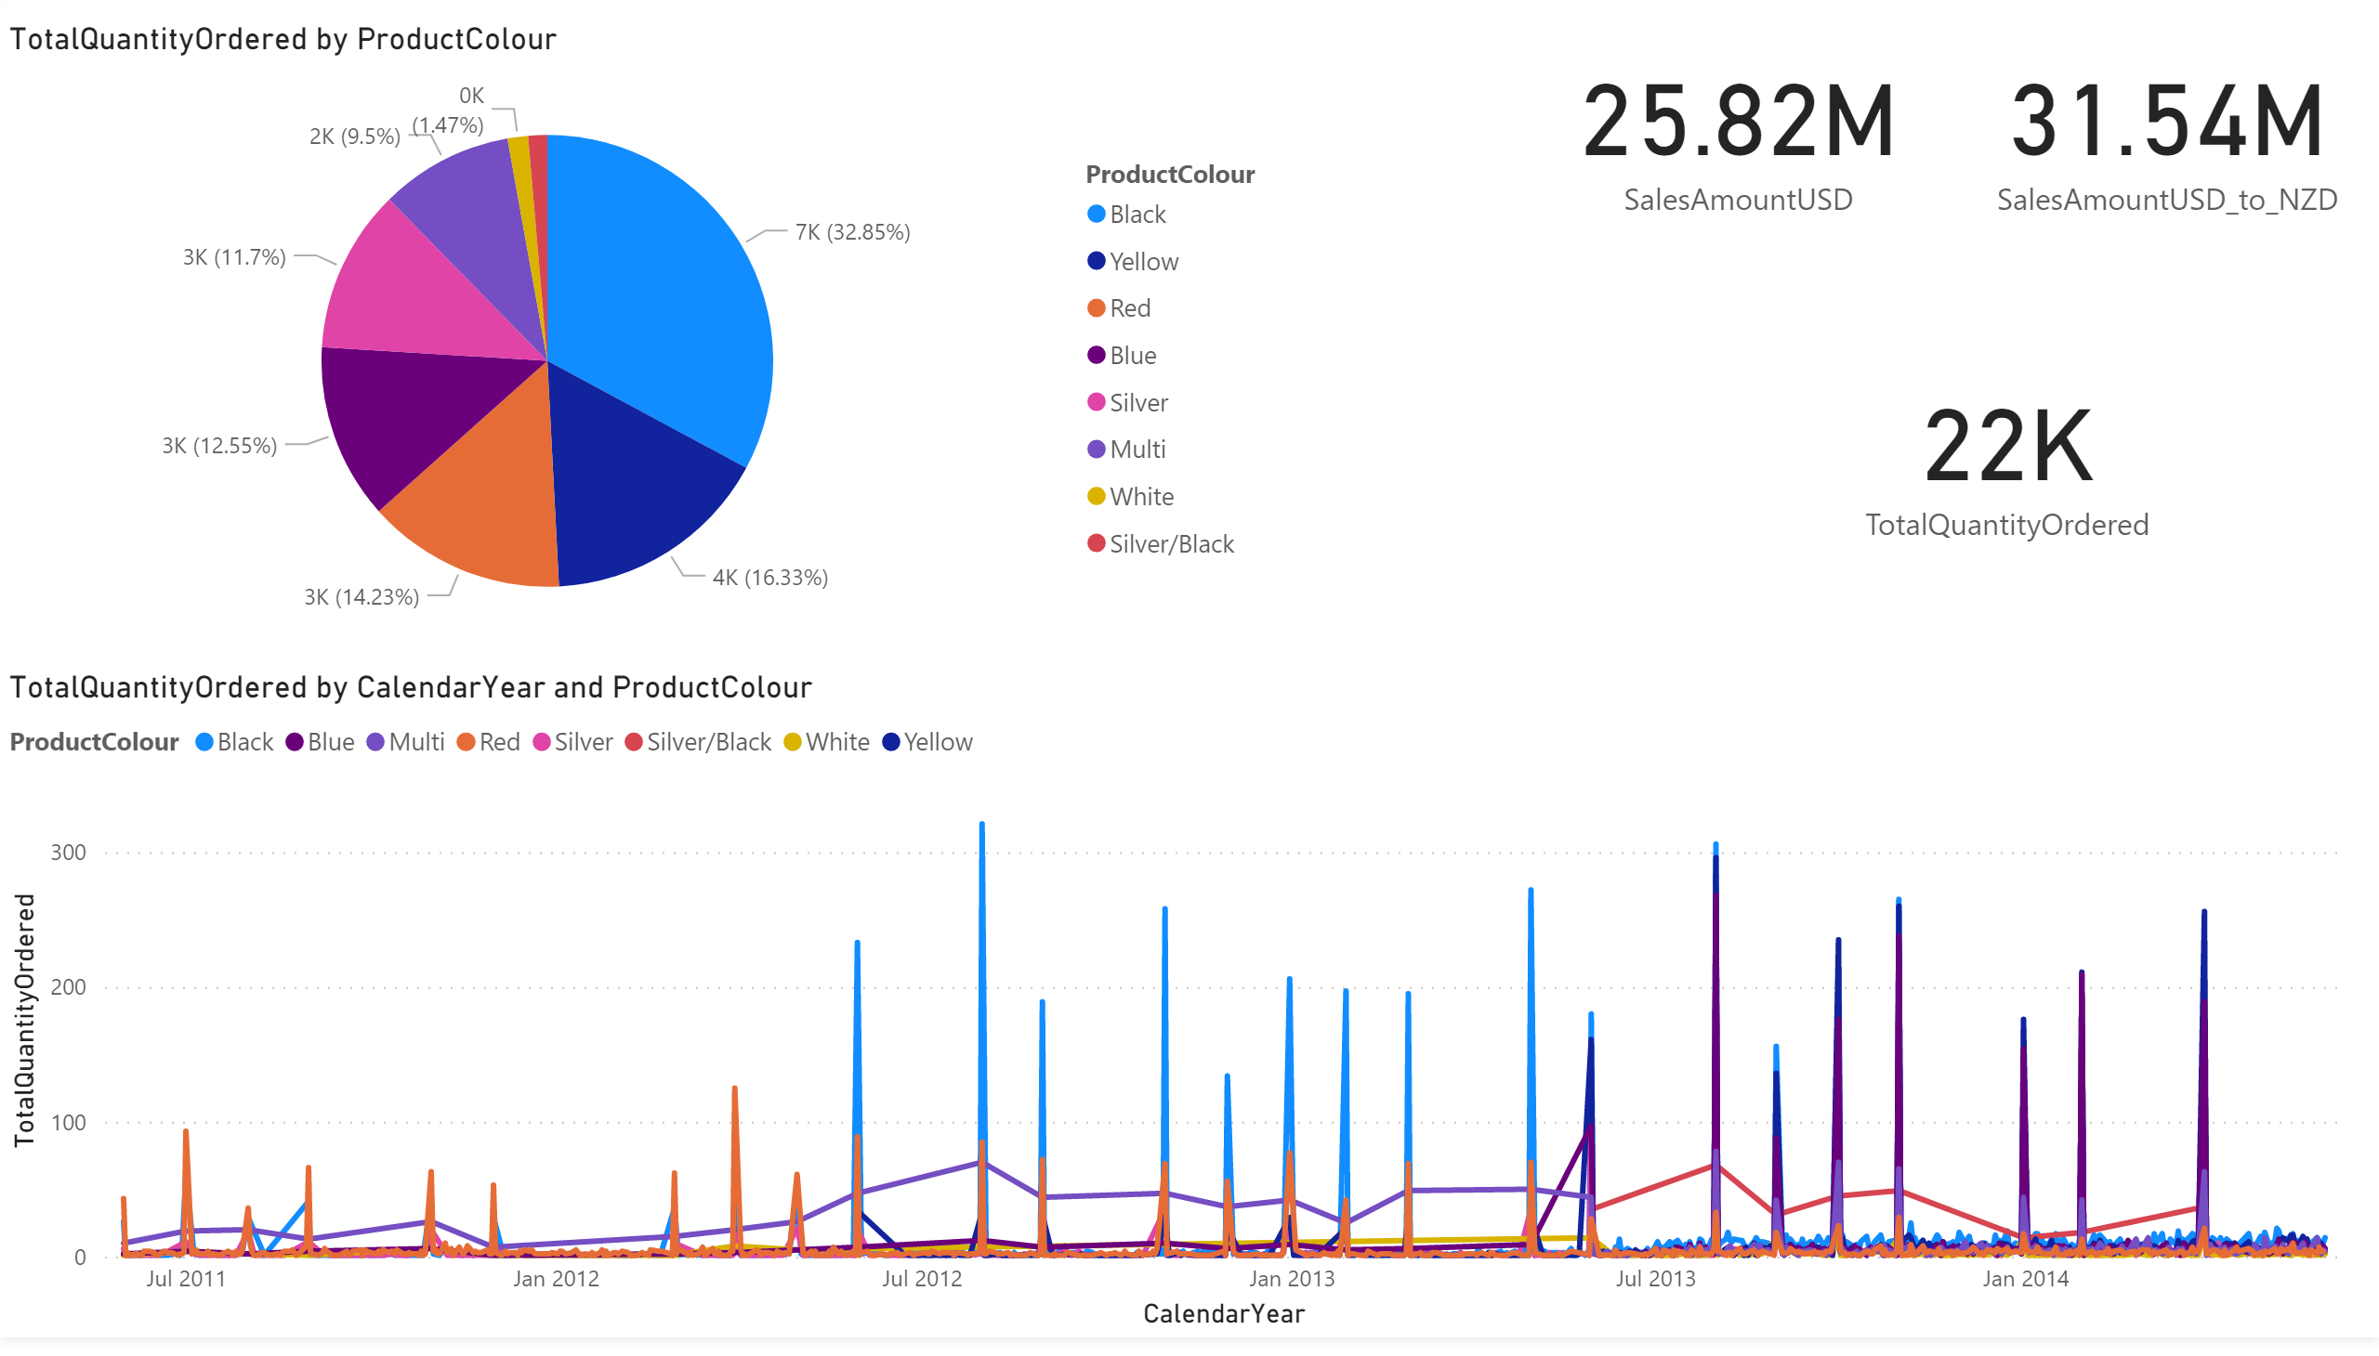
Report
Notes:
lineChart
No alt text provided.
card
No alt text provided.
card
No alt text provided.
pieChart
No alt text provided.
card
No alt text provided.

